Slide 1
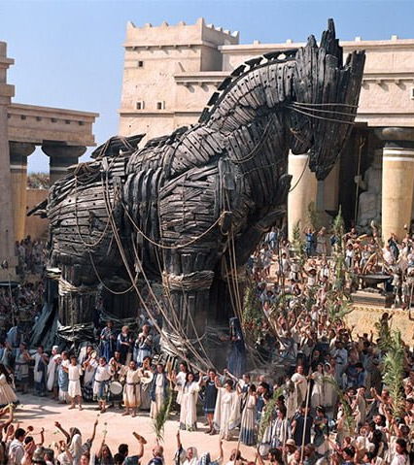
ESSAY WRITING 101
Goal/s:
Discuss ESSAY WRITING for task 2 – explanation (trojan war)
Week 7 Lesson 1
Ms Barrie

Slide 2
This week’s lessons:
WEDNESDAY
(today) – Introductions, Body Paragraphs, and Conclusions
THURSDAY
Review of Essay Writing, Sample Essay Analysis, Prep Time (notes page)
FRIDAY
In-class essay writing time (EVERYTHING DUE)

Slide 3

Discussion Question:
What makes a good essay?

Slide 4
A good essay will…
Answer the question
Have a clear argument
Use a clear structure
Use evidence to support points
Be written legibly
Use historical terminology
You must pretend I know NOTHING about this topic.
You must write clearly to TEACH me about it, and use evidence to support what you are saying…
… otherwise, why would I believe you?

Slide 5
ACTIVITY 1 – How to write an Essay
Cut out and glue the Essay Information Sheet in your workbook
We will read through the information provided and I will answer any questions during this time.

Slide 6
ACTIVITY 2 – Analyse a sample essay
Each of you will receive a copy of a sample essay.
We will discuss what makes this essay good.
We will highlight the structure of the essay.
We will provide feedback on the essay.

Slide 7
Introduction
The story of the Trojan War has played a crucial role in shaping the way the history of ancient Greece has been formed, and is an infamous example of ancient warfare. The writings of Homer in ‘The Iliad’ and ‘The Odyssey’ provide the main source of information regarding the Trojan War; though depictions in modern media including the 2004 film ‘Troy’ show another perspective of this myth. These exaggerated accounts of the story of the fall of Troy – both in film and texts – make it difficult to see a clear story of the Trojan War. Due to these reasons, it is hard to find any proof of the war of Troy as anything more than speculation and myth, excepting the discovery of a site that is believed to be the place of Troy in a village in modern day Turkey by Heinrich Schliemann in 1862. The archeological evidence has since been widely accepted as the ancient city of Troy, however, there is still large amounts of speculation regarding the content of the war, as there is little evidence suggesting the war occurred. This essay will compare and contrast the myth of the Trojan War as depicted in Homer’s text ‘The Iliad’ and the 2004 film ‘Troy’.

Slide 8
Body Paragraph
There are many similarities between the characters and events of the Trojan War shown in the two texts Homer’s ‘Iliad’ and the film ‘Troy’. There are many overlapping identifications of key Greek and Trojan heroes, victims, and warriors. An example of this is King Agememnon, who Homer highlights as fundamentally concerned with himself – using his cunning to manipulate people and situations for his own benefit (Book 2). These character traits are emphasised in the same way in the film Troy, with Agememnon utilising his brothers intentions (Menelaus) as a justification to take over Greece. Similarly, many events are described in the almost the same way in both texts. Both the film and book describe the events of Helen’s kidnapping, the battles of the Trojan War, and the significance of the Trojan Horse. The two texts share many similarities – particularly in characters and events.

Slide 9
Body Paragraph – Topic Sentence
There are several differences in depictions of key ideas in Homer’s ‘Iliad’ and the film ‘Troy’.

Slide 10
Begin your essay plan
Essay Plan | Ideas
Introduction
Body Paragraph 1
Body Paragraph 2
Body Paragraph 3
Conclusion

Slide 11
ESSAY PREP
Goal/s:
Discuss and prepare for task 2
Week 7 Lesson 1
Ms Barrie

Slide 12
ACTIVITY 1 – Writing Clearly
Fill in the blanks to create an introduction.
There are many |  | between depictions of… |  | In Homer’s Iliad and the 2004 movie ‘Troy’.
Homer’s Iliad tells the story of… | DESCRIBE HOMER’S ILIAD | , and the film Troy shows…. | DESCRIBE THE MOVIE TROY | . Both of these texts depict the story of the Trojan War.
The Trojan war… | BACKGROUND INFORMATION | And involved… | BACKGROUND INFORMATION | Though it is a myth due to limited archaeological evidence.
This essay will argue… | THESIS STATEMENT. | Firstly it will… argue what? | Secondly it will… argue what? | Lastly, it will… argue what?

Slide 13
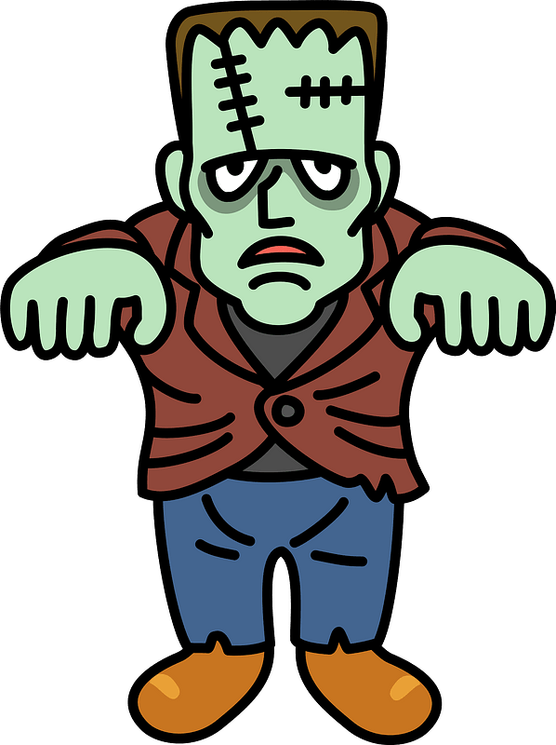
ACTIVITY 2 – Frankenstein’s essay
Each group will receive a piece of paper with a part of a body paragraph they must argue.
When complete, they must make a full essay with the matching other groups.
This must be glued on an A3 piece of paper.
You must then edit the work.

Slide 14

ACTIVITY 3 – Notes page
Use the A4 Notes page provided to write your notes page.
This will be taken into your essay, so make it GOOD!
It must be in short, dot-points only.
One-sided – only in the box provided.

